Slide 1
FitSet: Redefining Fitness with Hyper-Personalization
Combining Goal-Driven AI and Hyper-Local Context for Real Results

Slide 2
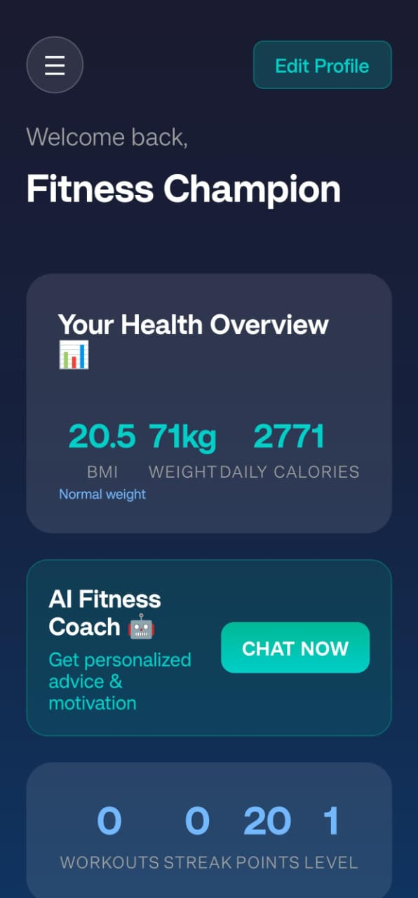
Introducing FitSet: Intelligent, Tailored Fitness
The Smart Core
FitSet transforms complex user data into simple, actionable daily plans. Our intelligent system processes 7 key inputs—including Body Type, State, and Food Preference—to generate comprehensive fitness strategies.
Goal-Driven Precision
Every recommendation explicitly supports one of three transformation pathways: Weight Loss, Bulking, or Lean muscle gain.
Instant Metrics
Users see their BMI, current weight, and daily calorie goals immediately upon login, providing clarity and direction from day one.

Slide 3
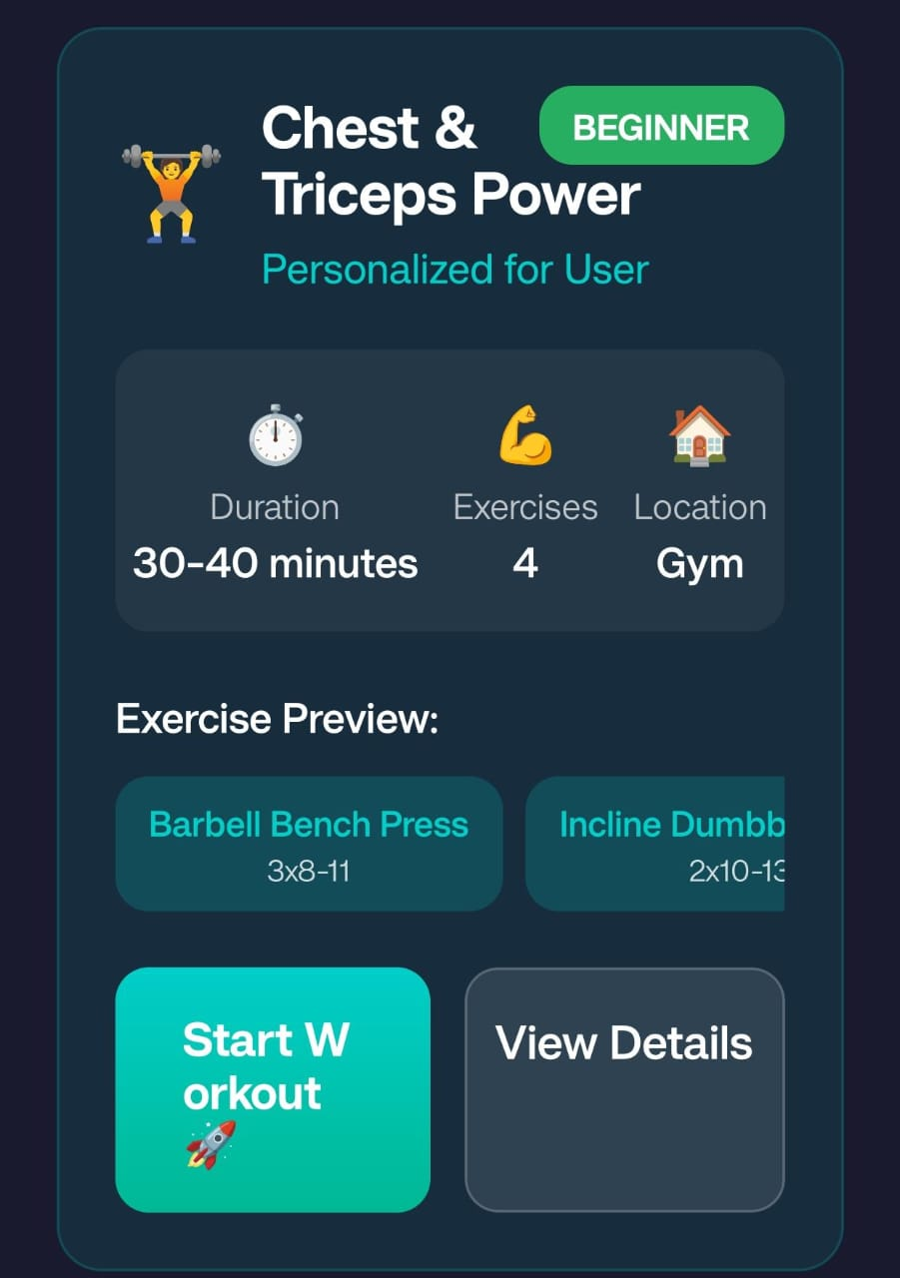
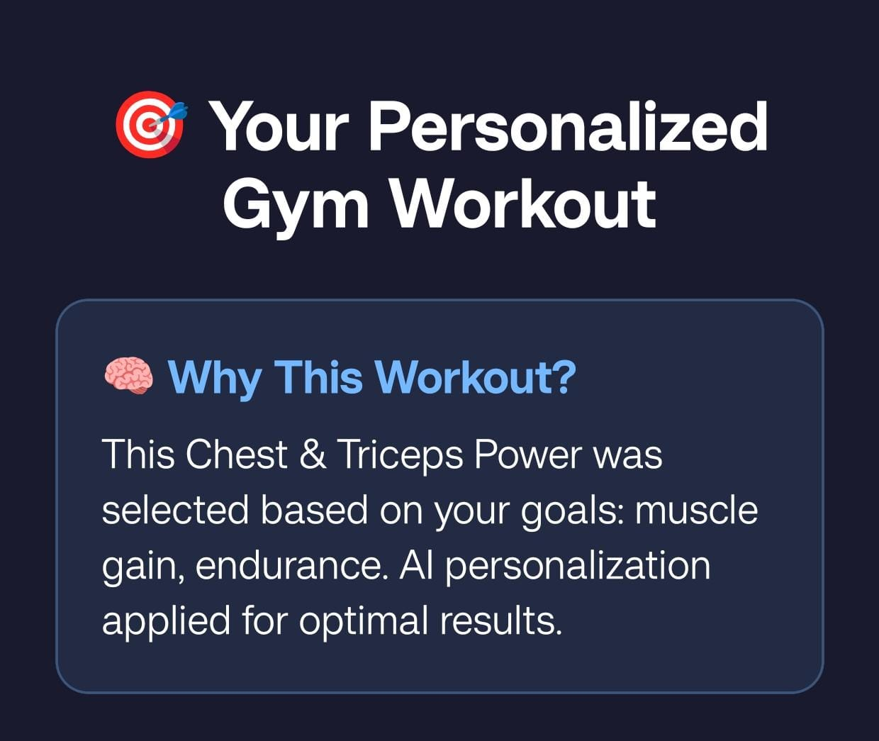
Adaptive Planning: Workouts, Cardio, and Sleep, Daily
AI-Generated Schedule
Creates a comprehensive daily timetable covering Workout Sessions, Cardio activities, Nutrition timing, and Sleep optimization based on user-defined time preferences.
Workout Customization
Supports three expertise levels (Beginner, Intermediate, Advanced) and adapts to two training environments: Home workouts with no equipment or full Gym-based routines.

Slide 4
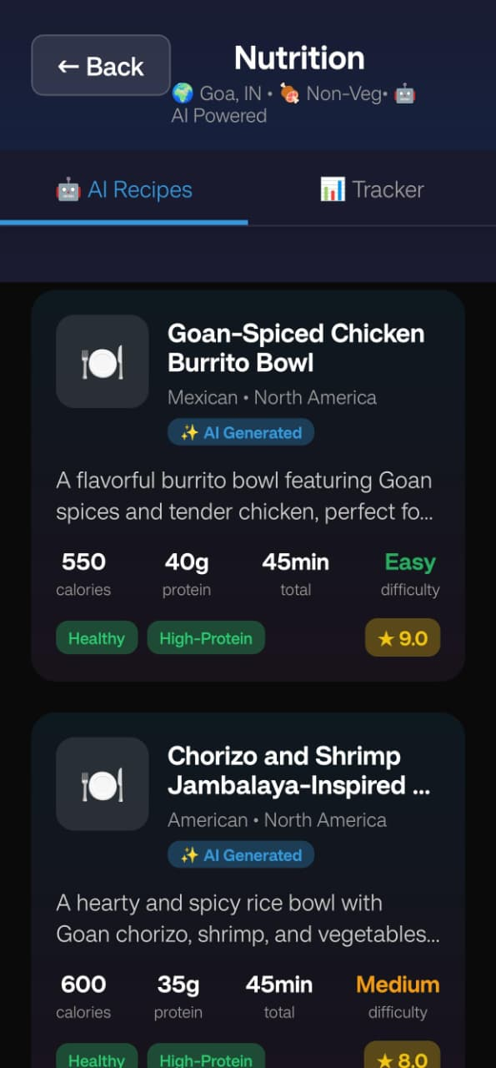



The Technology Under the Hood
Proprietary Algorithm
Processes 7 unique user inputs through advanced machine learning to map goal-specific, culturally relevant fitness and nutrition recommendations.
Built for Scale
Modular architecture designed to seamlessly add new regional diets, workout routines, and advanced features like wearable device integration.
Unique Value
The perfect blend of goal-based AI intelligence with hyper-local cultural content—a combination that doesn't exist in the market today.

Slide 5
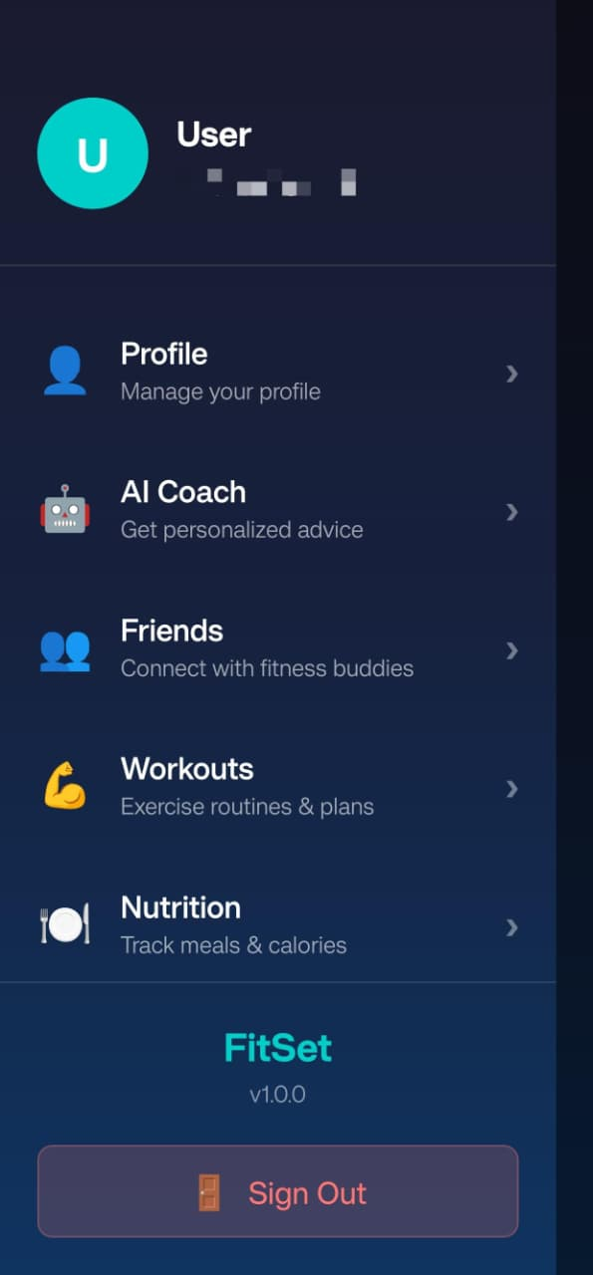
FitSet: The Future of Personalized Fitness is Here
What We've Built
Next Steps
A truly Personalized, Practical, and Indian-centric fitness solution powered by robust AI that solves the critical problem of generic, culturally disconnected fitness apps.
Full-scale beta launch targeting 50,000 users, expanding our recipe database to cover all 28 Indian states, and securing strategic partnerships with nutrition brands and gym chains.
Our Vision
Empower millions of Indian users to achieve their fitness goals effectively and sustainably through technology that truly understands their culture, lifestyle, and aspirations.
Support FitSet Today
Join us in revolutionizing how India approaches fitness and wellness. Together, we can make personalized health accessible to everyone.

Slide 6
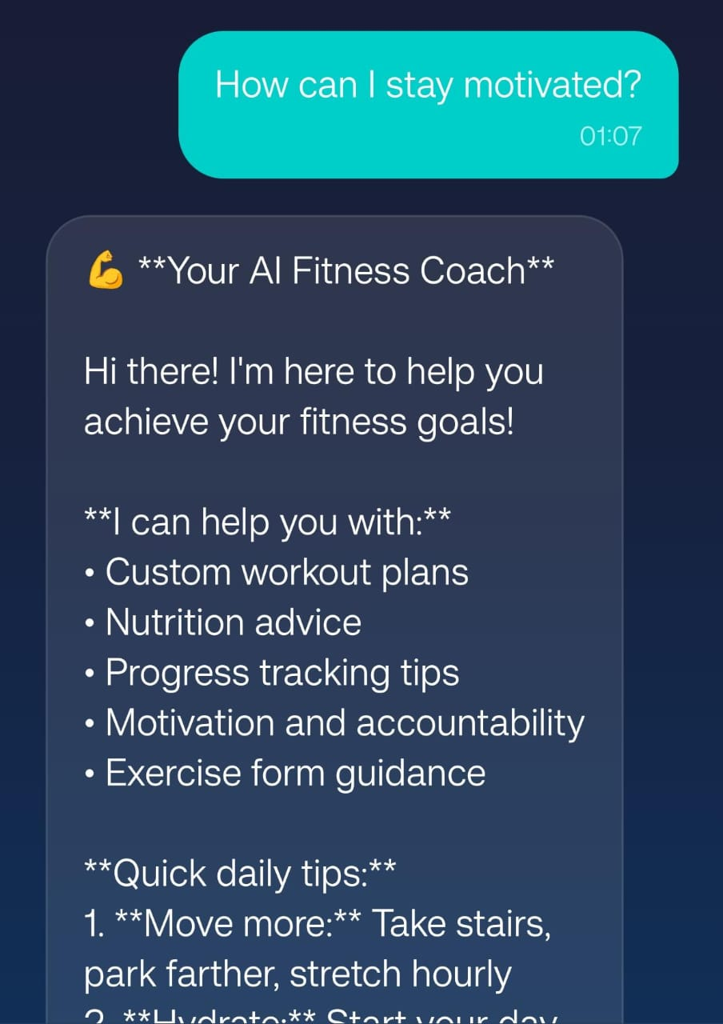
Data-Driven Motivation: Building Consistency
100%
24/7
Goal Tracking
AI Coach Support
Complete visibility into workouts completed, streak points earned, and user level progression
On-demand motivation and instant answers to fitness queries
Gamification Meets Social Support
FitSet transforms fitness into a measurable, rewarding journey. Our innovative Friends feature enables users to connect with fitness buddies, leveraging social accountability to dramatically increase adherence rates.
The Statistics and Progress Log turns every workout into tangible achievement, fostering a sense of accomplishment that drives long-term consistency.

Slide 7
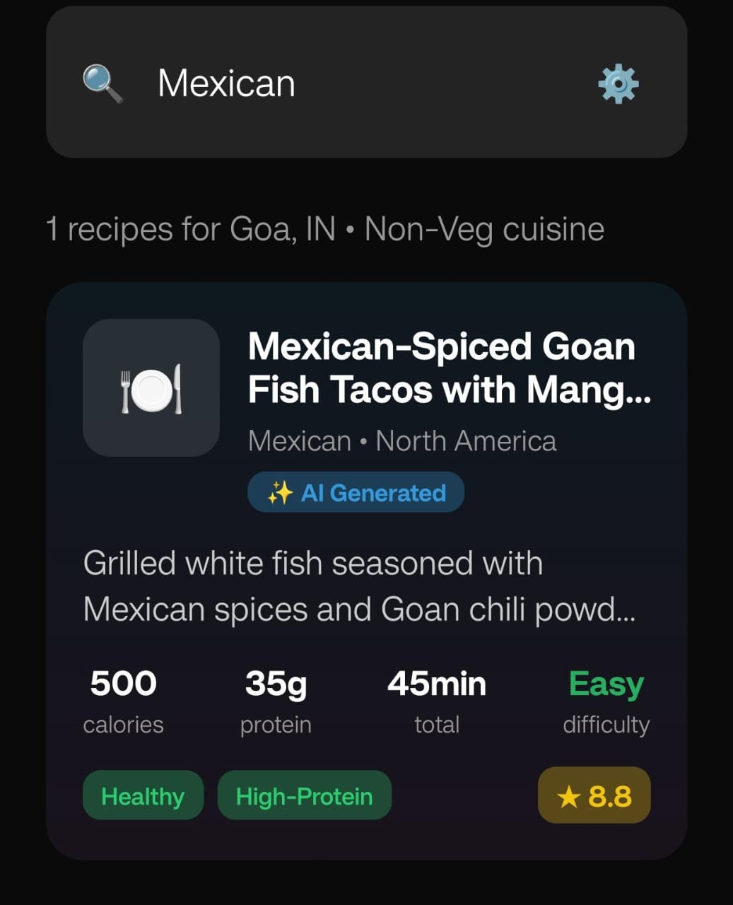
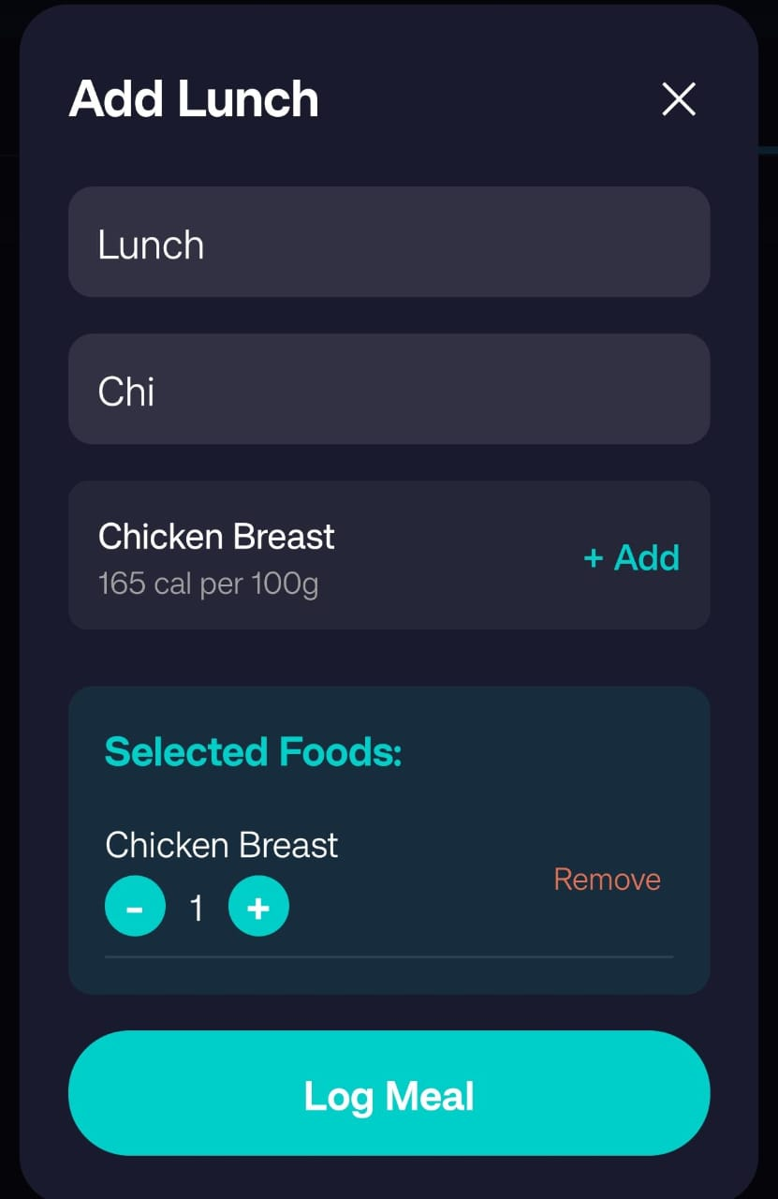
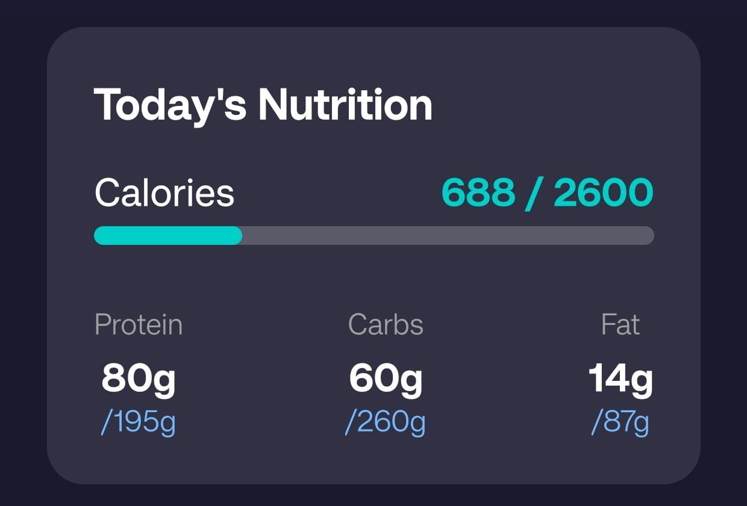
Hyper-Local Nutrition: Making Healthy Eating Delicious
Calorie-Goal Bridge
Local Cuisine Intelligence
Simple Meal Logging
The Nutrition Tracker displays daily calorie and macro targets—Protein, Carbs, and Fat—with real-time progress tracking to keep users aligned with their transformation goals.
AI Recipes suggests region-specific healthy dishes perfectly aligned with calorie goals, like Goan-Spiced Chicken Burrito Bowls adjusted for local health preferences and taste profiles.
Users effortlessly log meals and track caloric intake across Breakfast, Lunch, and Dinner, making nutrition management practical and stress-free.

